Slide 1

6th Grade Math
Unit 12, Lesson 6 Discovering Inverse Operations Volume 2, pg. 307

Slide 2


Benchmark
MA.6.AR.2.2
Write and solve one-step equations in one variable within a mathematical or real-world context using addition and subtraction, where all terms and solutions are integers.
volume 2, pg. 307

Slide 3
Integrated Mathematical Thinking and Reasoning Standards
MA.K12.MTR.1.1 Actively participate in effortful learning both individually and collectively.
MA.K12.MTR.2.1 Demonstrate understanding by representing problems in multiple ways.
MA.K12.MTR.4.1 Engage in discussions that reflect on the mathematical thinking of self and others.
MA.K12.MTR.5.1 Use patterns and structure to help understand and connect mathematical concepts.
volume 2, pg. 307

Slide 4

Learning Target
I can use manipulatives to discover the role of inverse operations when solving one-step addition and subtraction equations.
volume 2, pg. 307

Slide 5

Warm-Up
volume 2, pg. 307

Slide 6
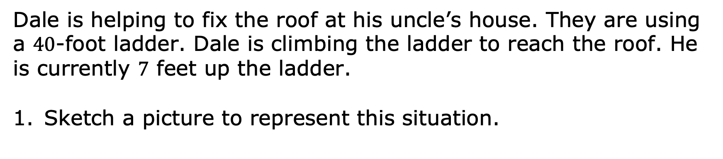
12.6.1 Warm-Up: Picture This
Dale is helping to fix the roof at his uncle’s house. They are using a $40$-foot ladder. Dale is climbing the ladder to reach the roof. He is currently $7$ feet up the ladder.
Sketch a picture to represent this situation.
volume 2, pg. 307

Slide 7
How much farther does Dale have to go to reach the roof? Include units.
volume 2, pg. 307

Slide 8

Exploration
volume 2, pg. 308

Slide 9



12.6.2 Exploration: Solving Equations Using Algebra Tiles
Algebra tiles can be used to represent and solve algebraic equations.
In the model shown, represents 1 and represents 𝑥.
The steps to determine the value of using algebra tiles are shown.
Work with your partner to complete the last step according to the description.
volume 2, pg. 308

Slide 10
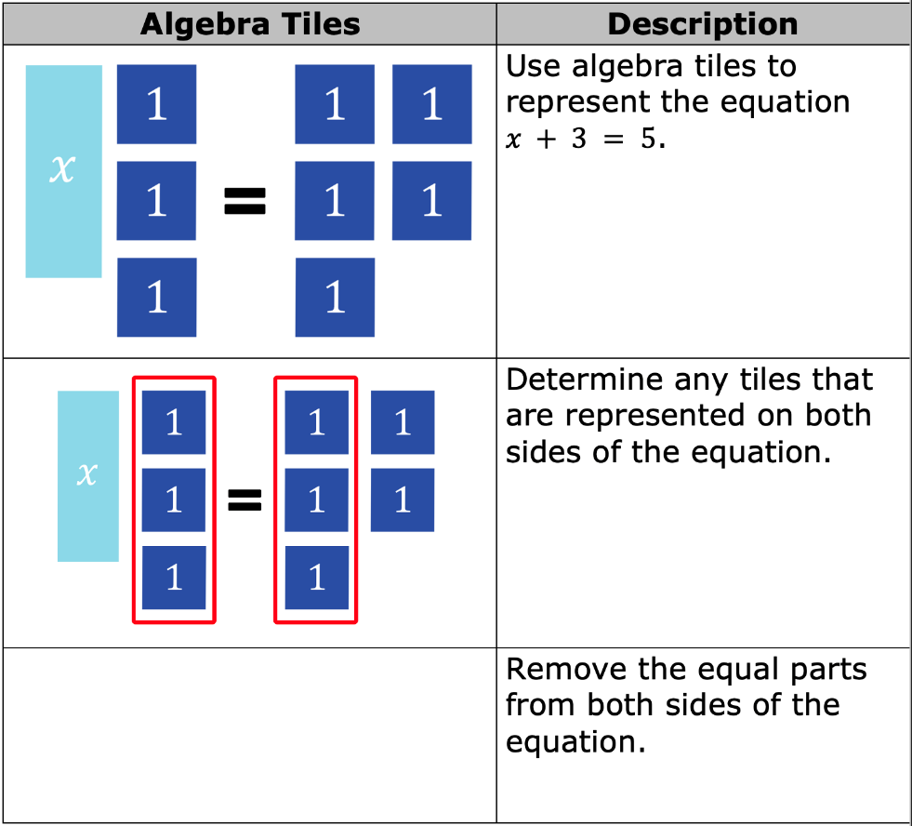
volume 2, pg. 308

Slide 11
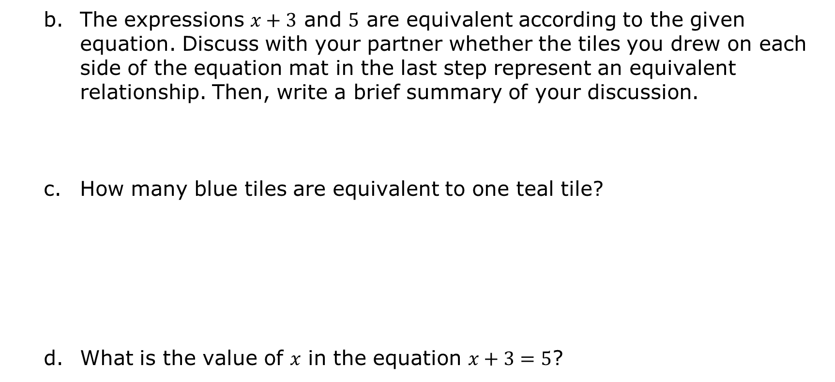
The expressions $x+3$ and $5$ are equivalent according to the given equation. Discuss with your partner whether the tiles you drew on each side of the equation mat in the last step represent an equivalent relationship. Then, write a brief summary of your discussion.
How many blue tiles are equivalent to one teal tile?
What is the value of 𝑥 in the equation $x+3=5$?
volume 2, pg. 308

Slide 12


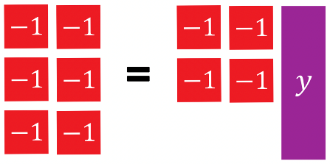
In the model shown, represents −1 and represents 𝑦.
Work with your partner to determine how many red tiles are equivalent to one purple tile.
volume 2, pg. 309

Slide 13
What is the value of 𝑦 in the equation $−6=−4+y$?
volume 2, pg. 309

Slide 14

Guided Instruction
volume 2, pg. 309

Slide 15

12.6.3 Guided Instruction: Solving Equations Using Inverse Operations
An equation relates two equivalent expressions. When solving an equation, the mathematical sentence must remain balanced so that the two expressions remain equivalent.
Discuss with your partner what it means for an equation to remain balanced. Then, summarize your discussion.
volume 2, pg. 309

Slide 16
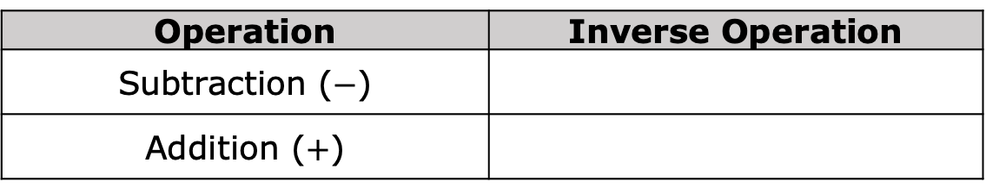
When finding the solution to an equation, inverse operations are used to balance an equation.
An inverse operation is an operation that reverses the effect of another operation.
Using the definition of inverse operations, complete the table to indicate which operation would reverse the given operation.
Operation | Inverse Operation
Subtraction ($−$)
Addition ($+$)
volume 2, pg. 309

Slide 17

Guided Practice
volume 2, pg. 310

Slide 18

12.6.4 Guided Practice: Using Inverse Operations to Solve Equations
Balance scales are used to measure weight, or mass. When both pans are at the same height, that means the objects in the two pans weigh the same amount. In mathematics, balance scales are often used to show balanced equations where the expressions on either side of the balance are equivalent.
volume 2, pg. 310

Slide 19
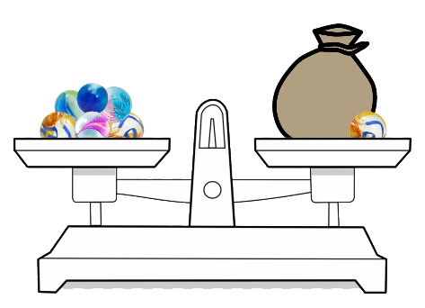
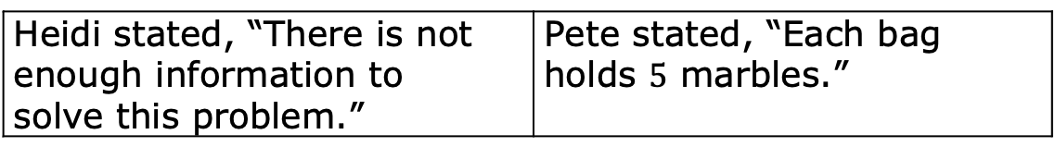
Heidi and Pete were given the balance scale shown below, which has exactly 6 marbles in the left pan. Heidi and Pete were asked how many marbles are in one bag.
Heidi stated, “There is not enough information to solve this problem.” | Pete stated, “Each bag holds $5$ marbles.”
Explain who is correct.
volume 2, pg. 310

Slide 20
Write an algebraic equation to represent the balance scale problem Heidi and Pete were given.
How many marbles are in one bag?
What inverse operation can be used to solve the equation?
volume 2, pg. 310

Slide 21
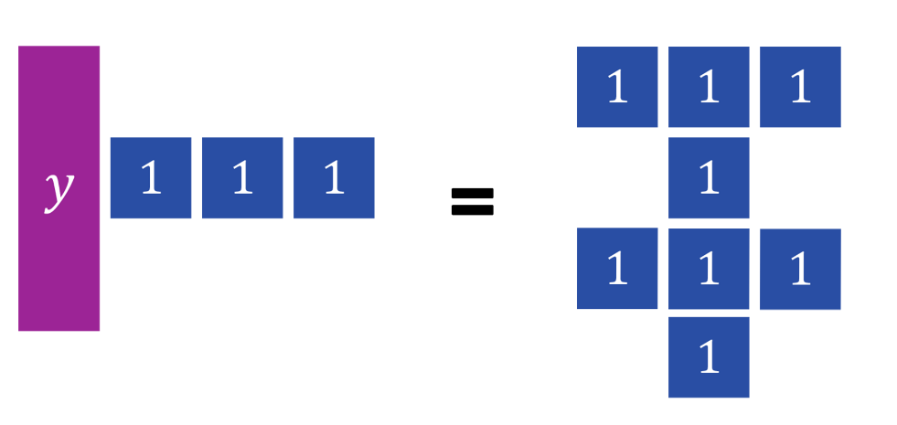
The algebra tiles shown are used to model an equation.
How many blue tiles are equivalent to one purple tile?
volume 2, pg. 311

Slide 22
Write a one-variable equation to represent the tiles on the mat.
What inverse operation can be used to solve the equation?
What value of 𝑦 makes the equation true?
volume 2, pg. 311

Slide 23

Your Turn
volume 2, pg. 311

Slide 24

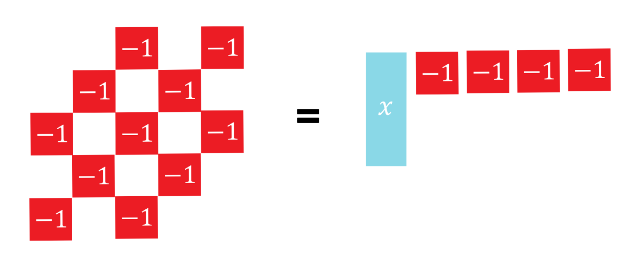
12.6.5 Your Turn!
The algebra tiles shown are used to model an equation.
How many red tiles are equivalent to one teal tile?
volume 2, pg. 311

Slide 25
Write a one-variable equation to represent the tiles on the mat.
What inverse operation can be used to solve the equation?
What value of 𝑥 makes the equation true?
volume 2, pg. 311

Slide 26
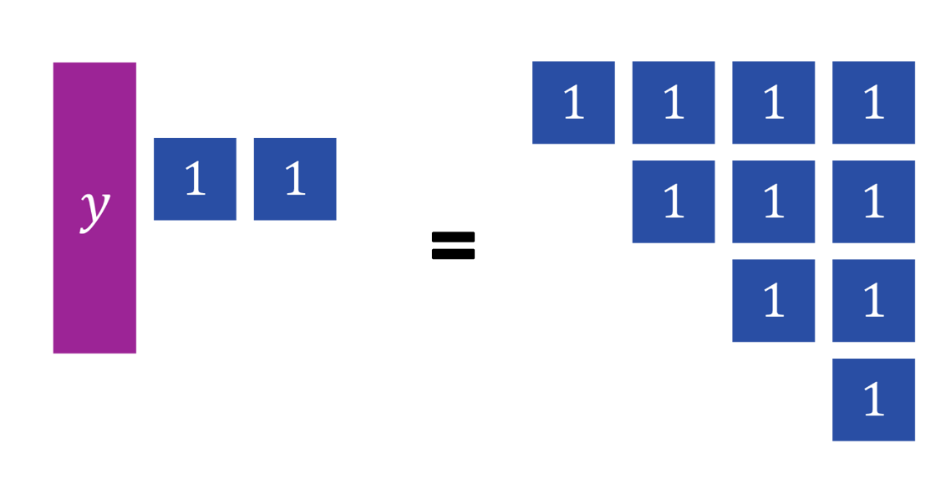
The algebra tiles below model an equation.
How many blue tiles are equivalent to one purple tile?
volume 2, pg. 312

Slide 27
Write a one-variable equation to represent the tiles on the mat.
What inverse operation can be used to solve the equation?
What value of 𝑦 makes the equation true?
volume 2, pg. 312

Slide 28

Wrap-Up
volume 2, pg. 312

Slide 29
12.6.6 Wrap-Up: Cool Down
Write a short note to a friend who missed class summarizing today’s lesson.
volume 2, pg. 312

